Slide 1
Noble Ltd.
(company profile)
Address: 10 Rasul Rza Str, AZ1000, Baku, Azerbaijan
Phone: +994 12 497 31 64
Fax: +994 12 493 49 98
E-mail: info@noble.az
Web: www.noble.az
Updated January 2015
DISCLAIMER: This presentation has been prepared exclusively for the benefit and internal use of the recipient and does not carry any right of reproduction or disclosure. Neither this presentation nor any of its contents maybe used for any other purpose without the prior written consent of Noble Ltd.

Slide 2
Outline
Briefly about us
Activity timeline & look-ahead
Vision, values and business philosophy
Market overview
Back-up slides

Slide 3
Briefly About Us
Founded in 1999. Owned by private entrepreneurs.
Started from a multi-brand shop of exclusive Italian apparel.
Today running 14 premium-class fashion shops in the center of Baku representing such renown Italian brands as Brioni, Stefano Ricci, Canali, Artioli, Angelo Galaso, Umberto Bilancioni, Castello D’Oro, Hettabretz, Schiatti, Rossini and others.
Also representing De Lamerie, the world-famous manufacturer of the finest china, crystal and silver tableware; and Braganti, supplier for Faberge.
Total No. of employees 87.
Increased client base by c. 10% p.a. in the past 3 years through delivering top quality customer service, conducting a thorough analysis of customer demand, and moving to a new level of partnership with premium-class Italian brands, securing Noble’s exclusive franchising rights in Azerbaijan.
Currently executing a large-scale project in Baku and appraising a number of medium/large scale projects in Azerbaijan, Turkey and Russia.

Slide 4
Activity Timeline
&
Look-Ahead

Slide 5
Activity Milestones and Look-Ahead
1995
2000
2014
2015-2020
1999
Retail activity started
Retail scope expanded
Completing additional Boutiques in Luxury Fashion Center
Noble Ltd founded
Project - Appraise; Luxury Fashion boutique Moscow, Russia
Project – Appraise; Luxury real estate (property development, design & construction) Baku, Az
Project – Appraise; Luxury Wholesale Center in Free Zone Istanbul, Turkey
2005
2 large-scale projects executed: opening of Brioni and Canali mono-shop boutiques in Baku
2006
2 large-scale projects executed: opening of Stefano Ricci and Artioli mono-shop boutiques in Baku
2012
2013
Large-scale project executed: opening of Rossini mono-shop boutique in Baku
Project – Execute; Go live - 3Q'13; Luxury Fashion Center Baku, Az
Ongoing retail activities / operations

Slide 6
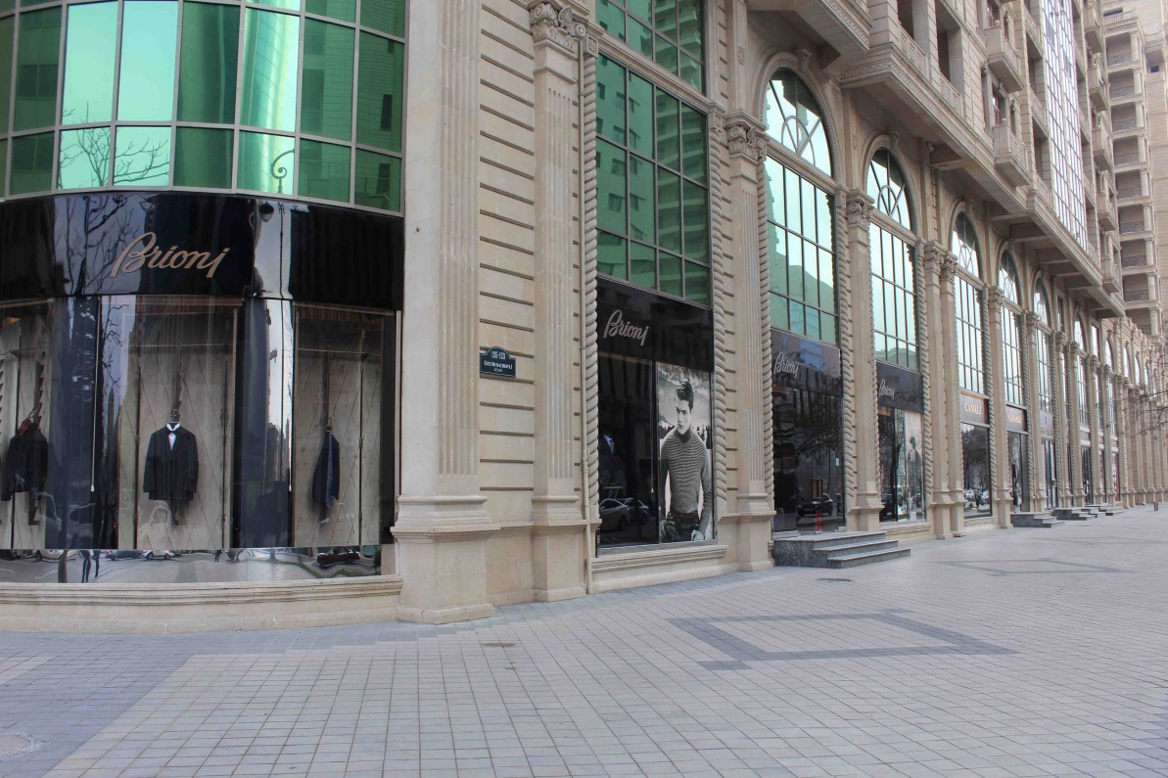
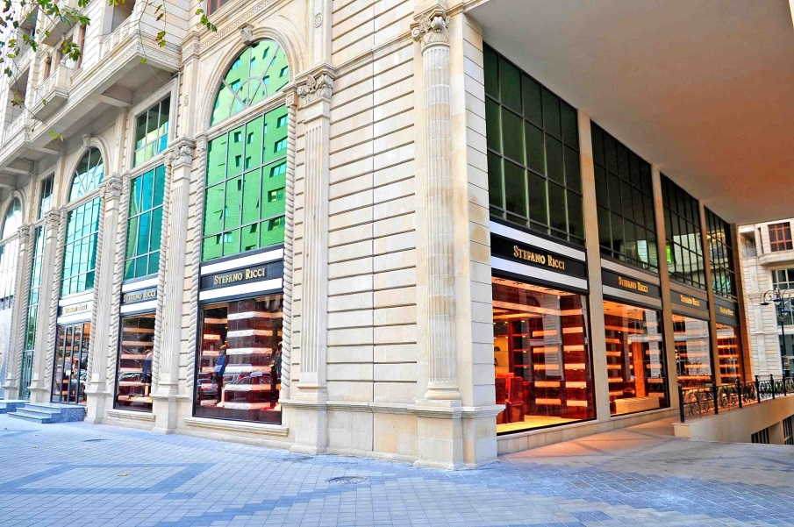
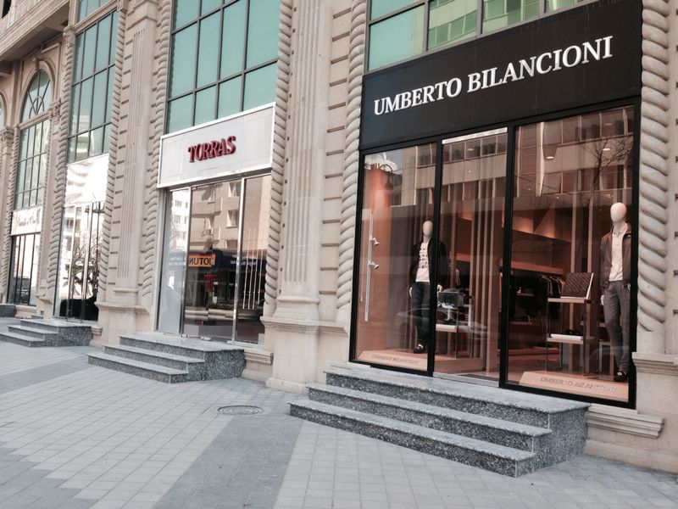
Luxury Fashion Center
- Project -
(Baku, Az)

Slide 7
Vision, Values
&
Business Philosophy

Slide 8
Vision
“Continue to grow as a dynamic and profitable premium-class fashion retail company, representing exclusive brands of ready-to-wear and made-to-measure clothing and accessories for men, gradually broadening our geographic borders and existing scope of business”.
Notes:
8

Slide 9
Values
Good corporate citizenship
Professionalism
Customer trust
Quality focus
Dignity of the individual

Slide 10
Business Philosophy
Strong operational cash flow to foster company growth
Strong synergies during project execution
Leading market
share position
Noble Ltd. is
a steady growing company
that currently offers c. 70%
of preferred luxury fashion
brands for men
in Azerbaijan
Experienced management team with proven record
Strong and recognizable brands only
Engaged and committed workforce
Long-standing relationships with the elite client base
Focus on strong financial performance

Slide 11
Market Overview

Slide 12
Market Overview
Rapid market development in the sector of luxury goods and services in Azerbaijan.
Approx. 70% of preferred luxury fashion brands for men are franchised by Noble Ltd.
In our humble opinion, in the next 5 years we will witness at least a 7-8% growth trend in this particular market niche.
The biggest risk factor, as we see it at this point, is a micro- and macro-economical stability. While the manageability of this risk on the part of Noble is not very high, we believe that the probability of this risk is medium.

Slide 13
Back-up Slides

Slide 14
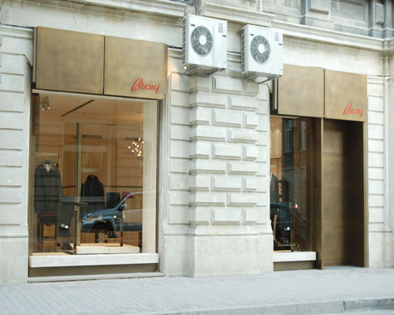

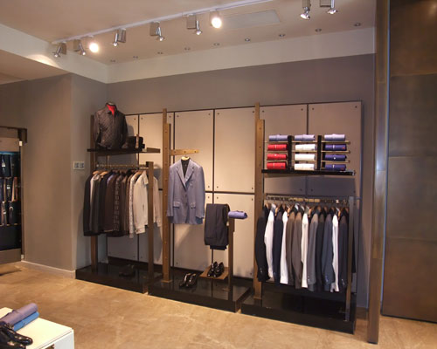
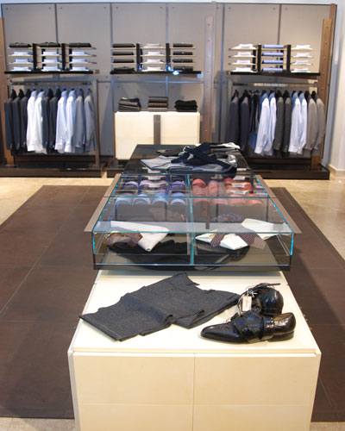
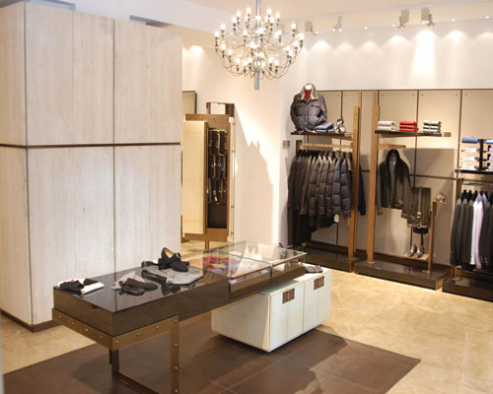

Slide 15
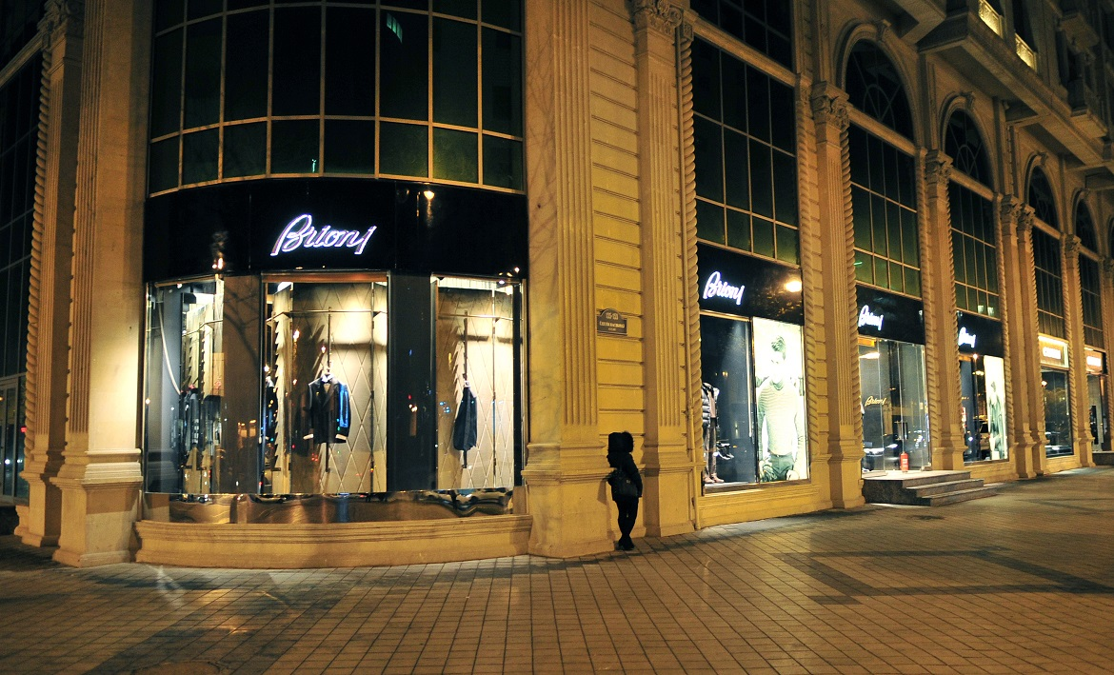
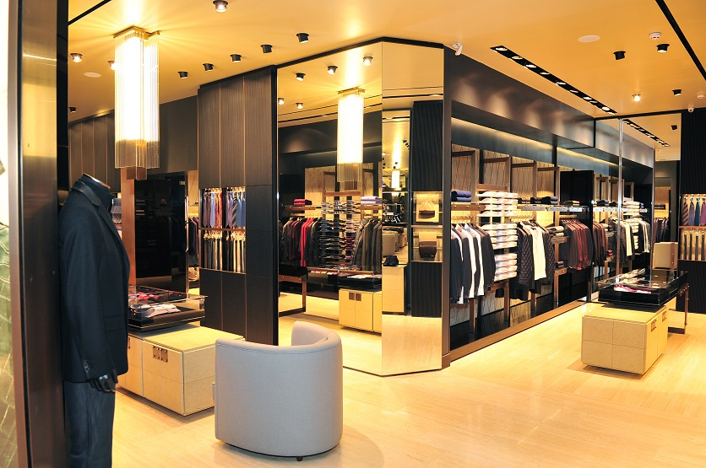
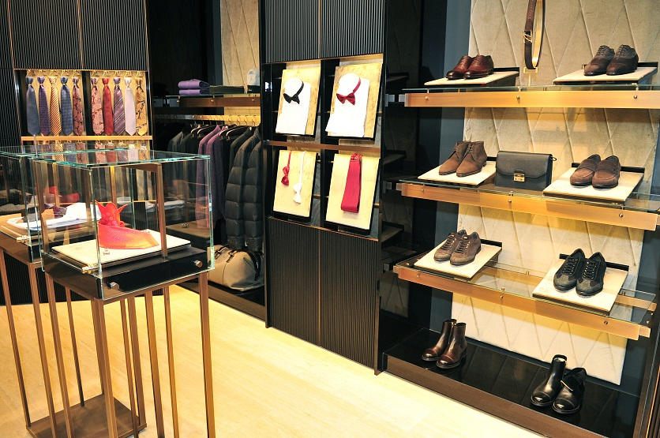

Slide 16
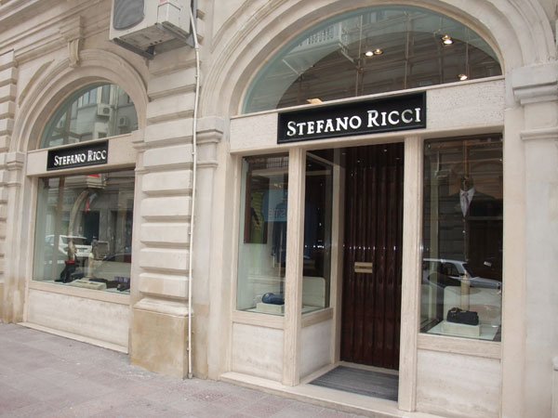

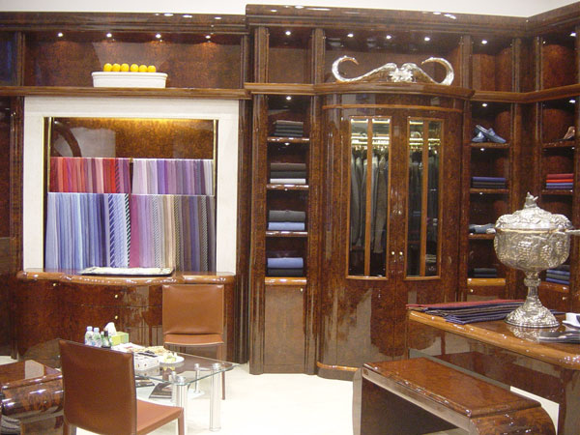
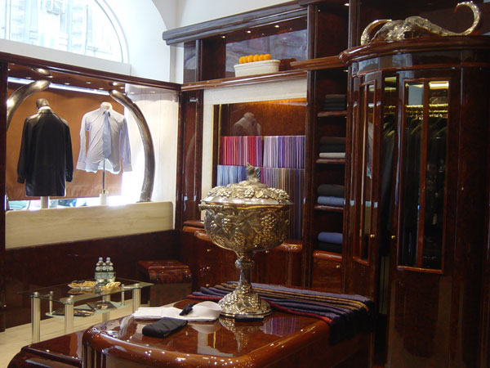
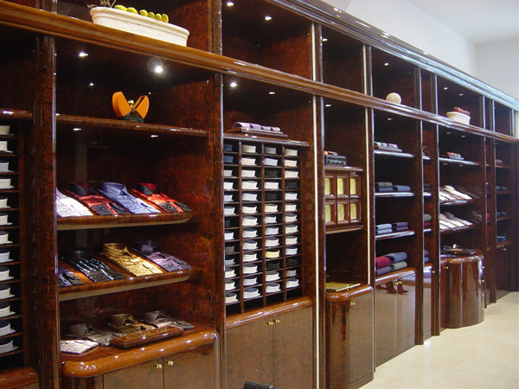

Slide 17
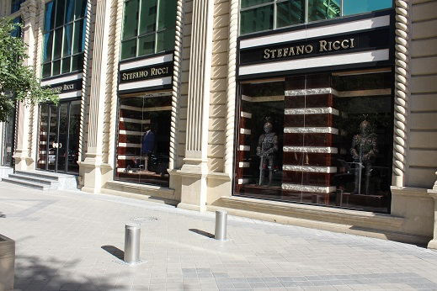
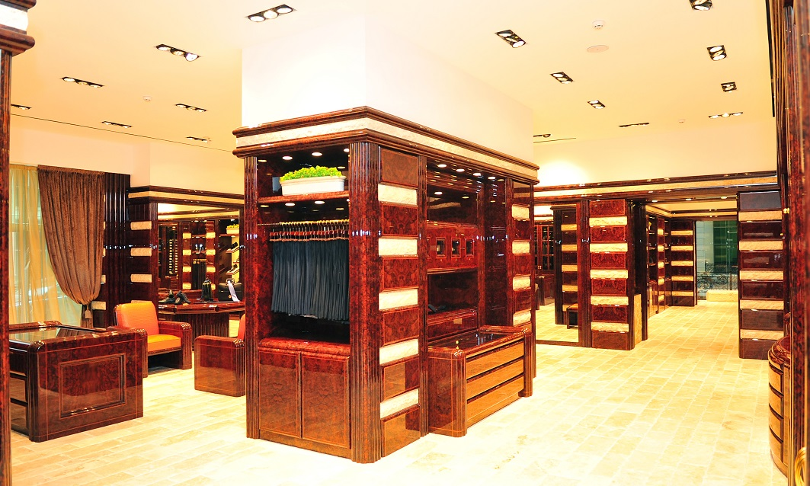
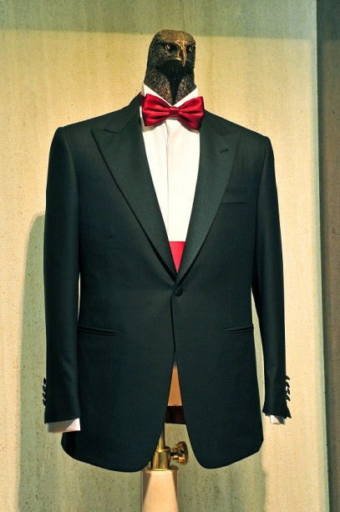

Slide 18
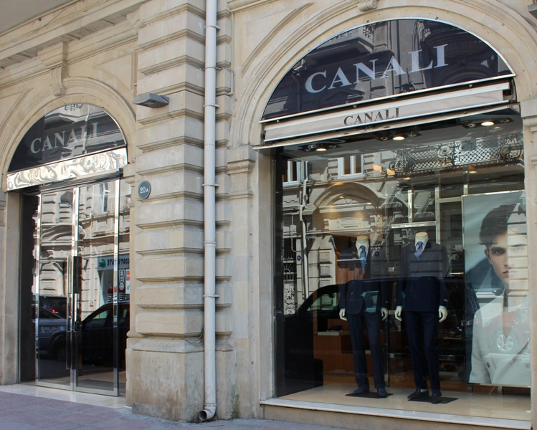

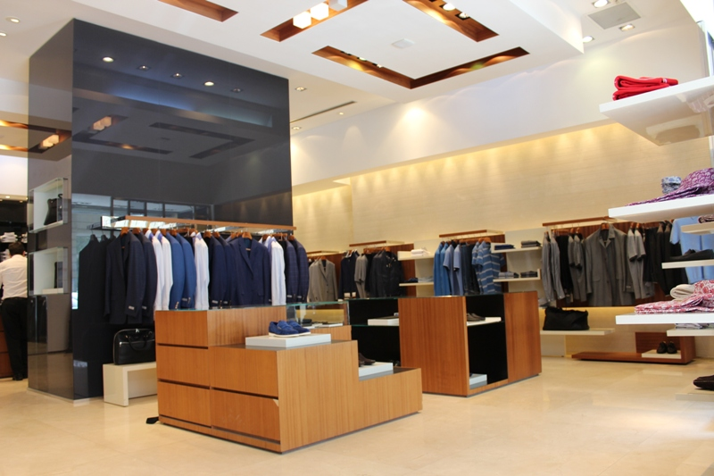
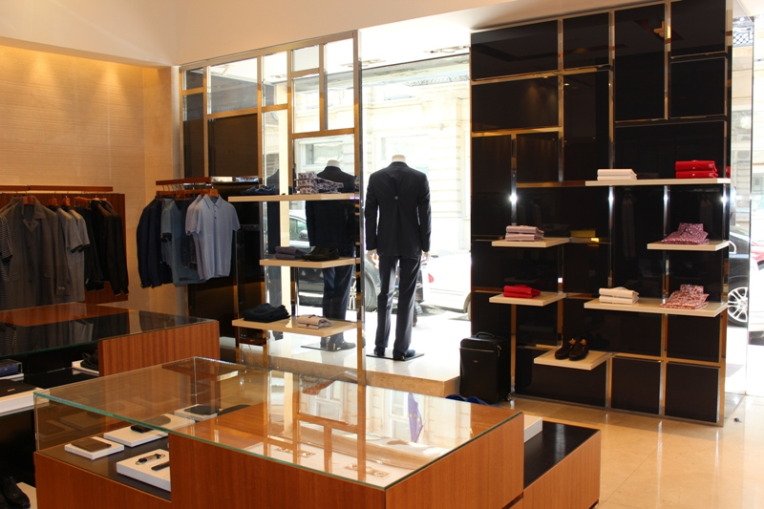

Slide 19
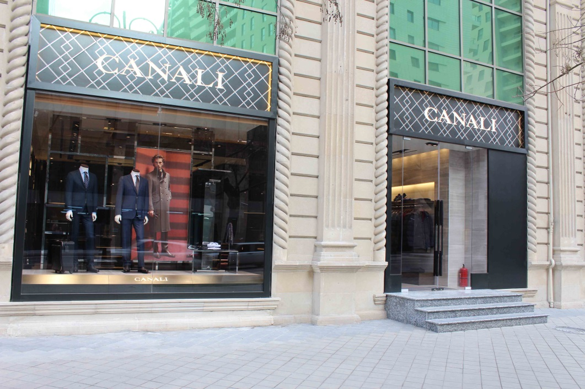
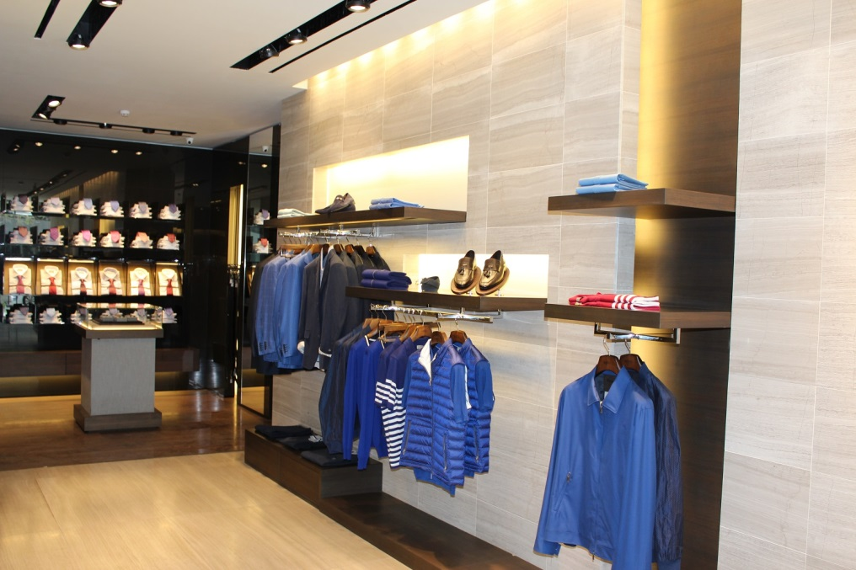
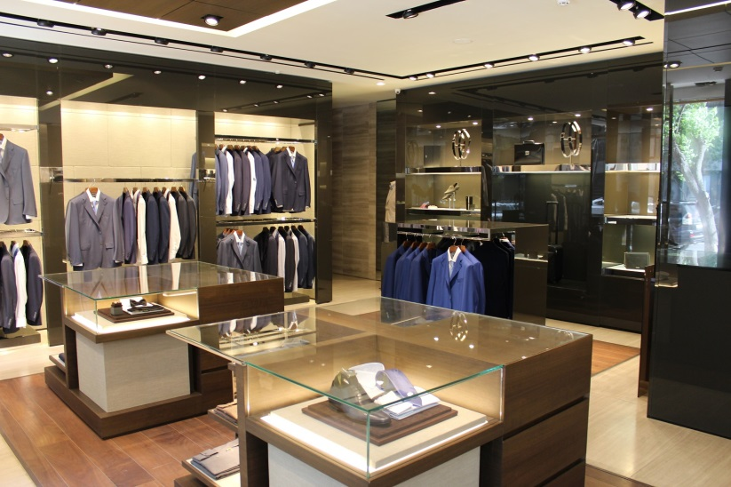

Slide 20
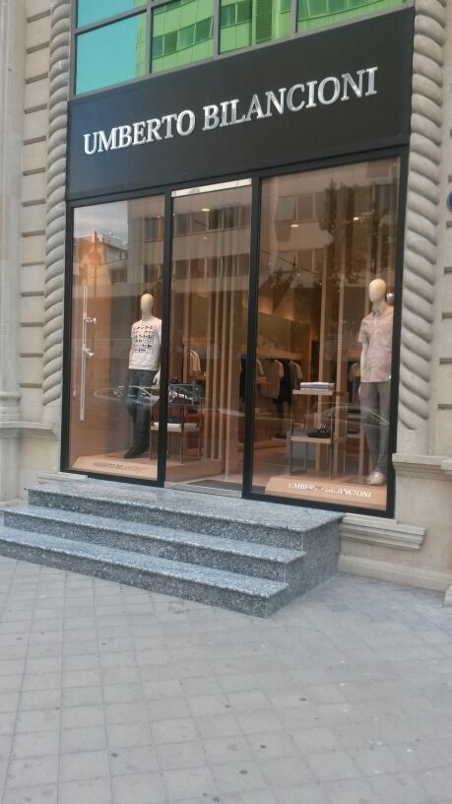

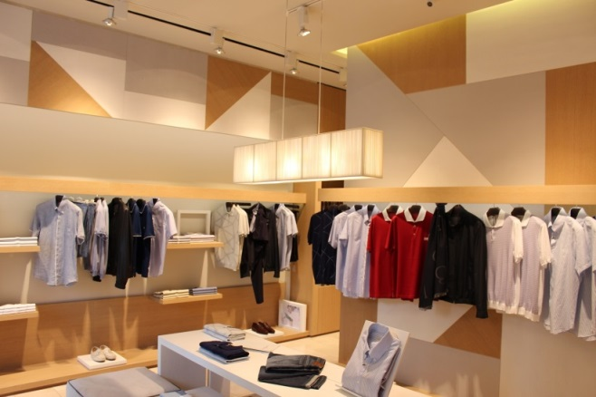
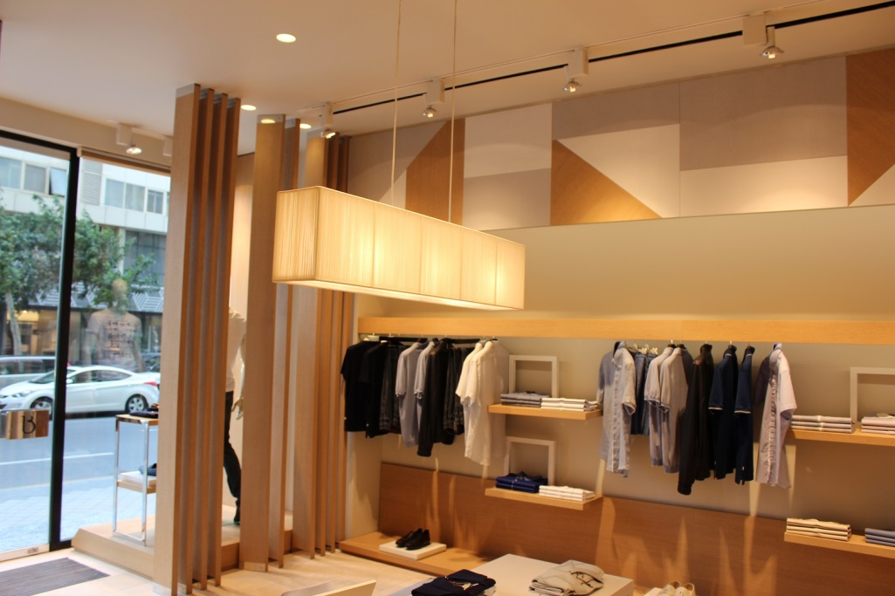
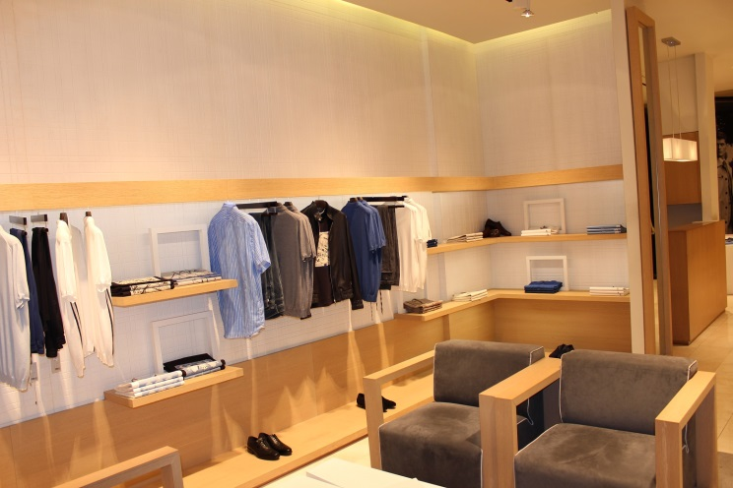

Slide 21

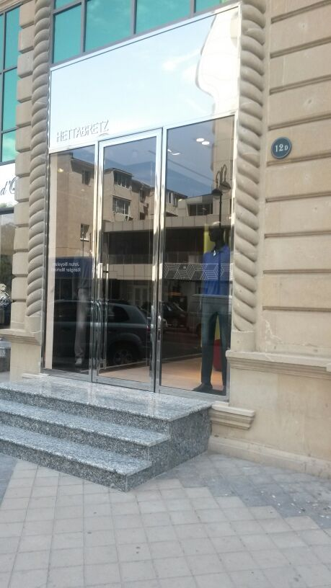
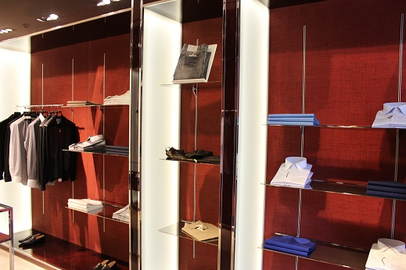
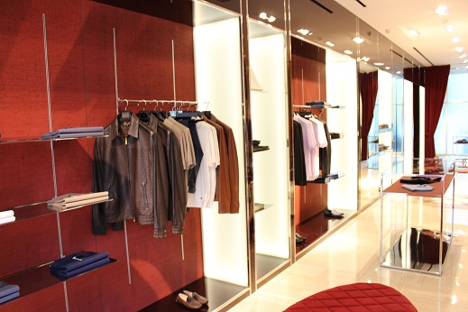
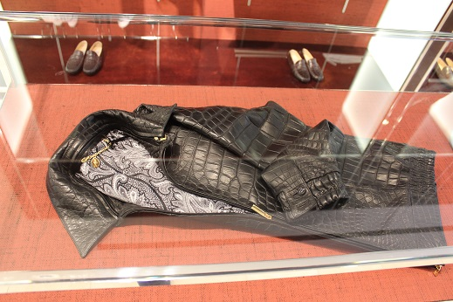

Slide 22
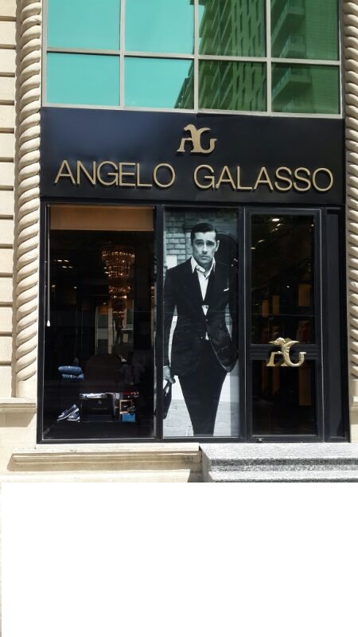
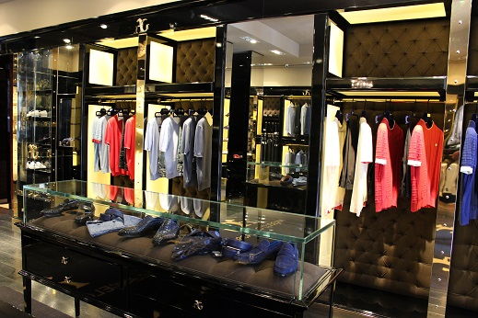

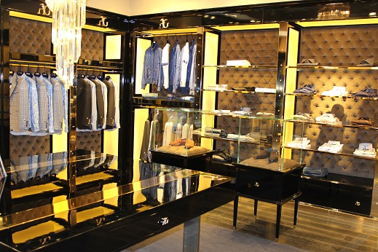
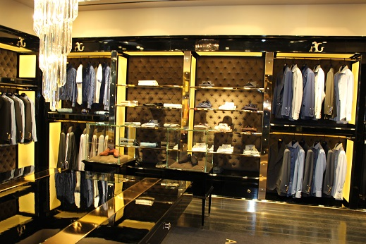

Slide 23
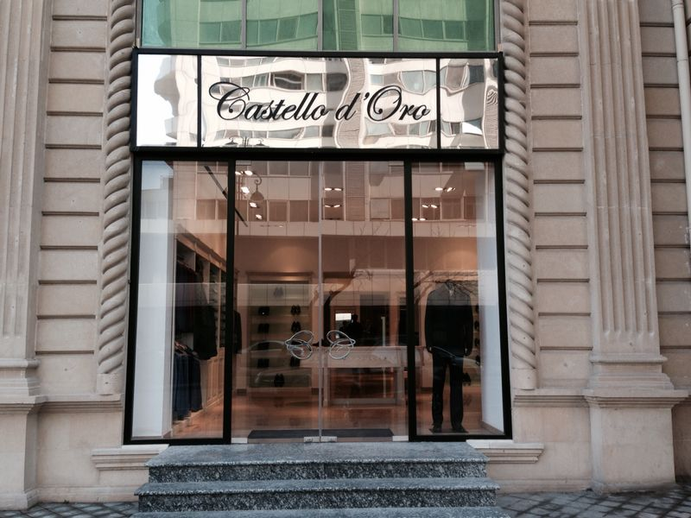

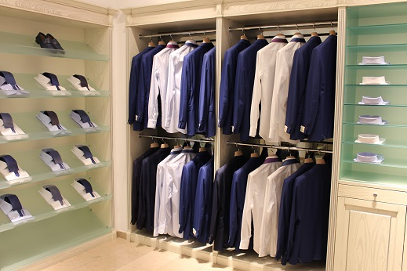
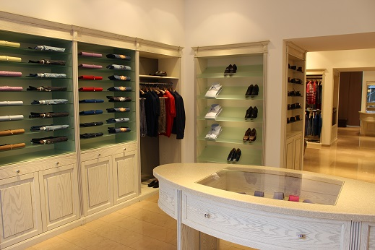
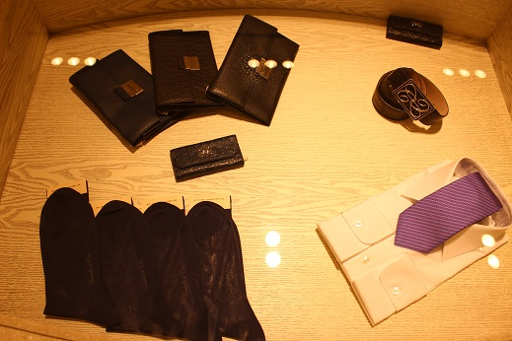

Slide 24
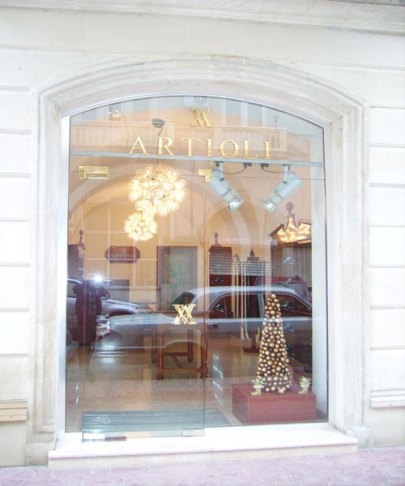

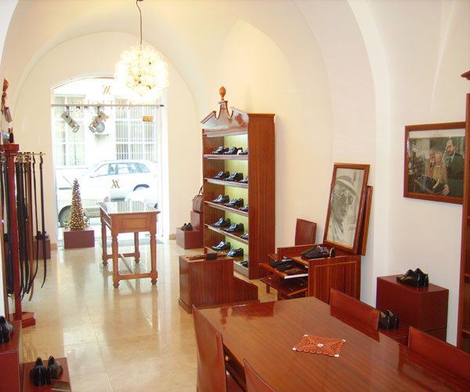
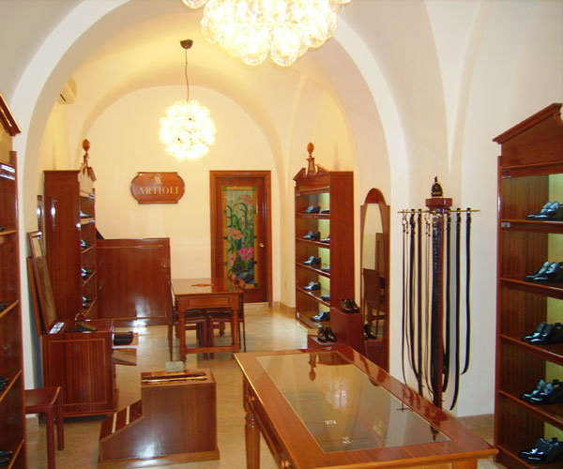

Slide 25







